Slide 1
Deconvolution of Laser Scanning Confocal Microscopy Volumes: Empirical determination of the point spread function
Eyal Bar-Kochba
ENGN2500: Medical Imaging
Professor Kimia

Slide 2
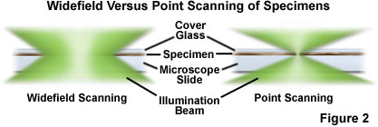
What is Laser Scanning Confocal Microscopy (LSCM)?
Light is captured by scanning the focused beams of laser light across the specimen.
Enables the collection of true 3-D data of specimens with multiple labels.
Out-of-plane light is blocked by the detector pinhole aperture.
Allows visualization of deeper structures of specimen.
Higher resolution than standard widefield microscope.
Anatomy of the Spine
Working operation of the LSCM [1]

Slide 3
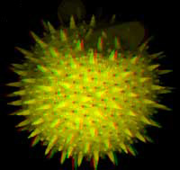
High resolution images taken with LSCM
Minimal spatial blurring of fibroblast images [2]
Nueron after segmentation [3]
Image of volume stack [2]

Slide 4
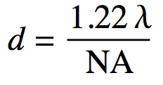
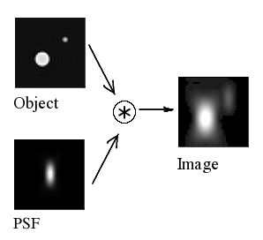
The inherent issue with optical microscopes: The point spread function
Any optical microscopes response to an object that is a point source and under the resolution is point spread function (PSF).
The PSF is highly dependant on the hardware of your imaging system, e.g. objective, imaging temperature, fluorescence color, etc…
Any image formed is the convolution of the object with the PSF.
Idealized PSF of a LSCM : X-Z has worse spatial blurring

Slide 5
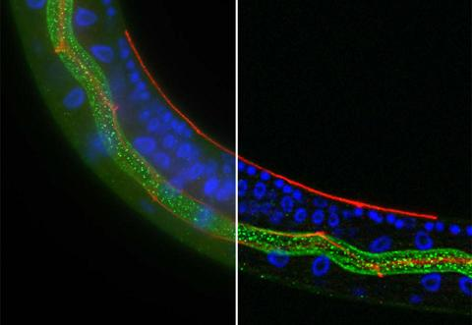
Deconvolution mitigates blurring due to the PSF
Convolution of the object with the PSF is reversible in principle by taking the inverse FT of the result.
However, due to inherent noise in the system, the inverse FT would simply amplify the noise.
Also, the PSF for your specific system would have to be accurately known for every experiment.
Blurred Image
Deconvoluted Image
Blurred Volume
Restored Volume

Slide 6
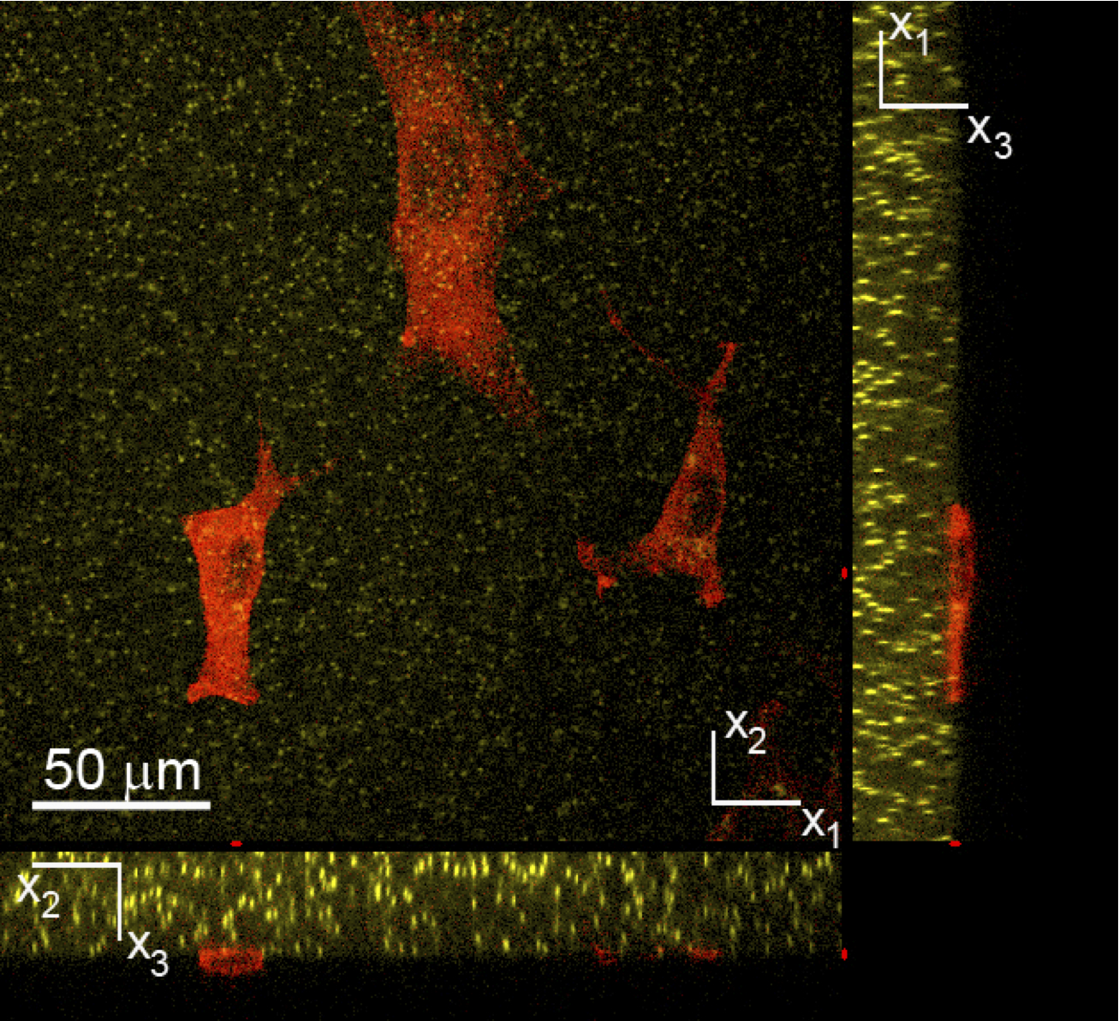
Statistical determination of the PSF from micro-fluorescent beads.
To deconvolve the data, a good estimate of the PSF must be known for every system.
The biological specimens imaged in the Franck Lab contained fluorescent beads (500 nm diameters) that are used to do Digital Volume Correlation (DVC).
DVC allows us to look at the traction forces that cells impose on there three dimensional environment.
Conveniently, these Fluorescent beads can be used to determine the PSF of the system because they are under the resolution of microscope.
Volume obtained used LSCM in lab. The yellow particles are the fluorescent beads that can be seen as PSF.

Slide 7
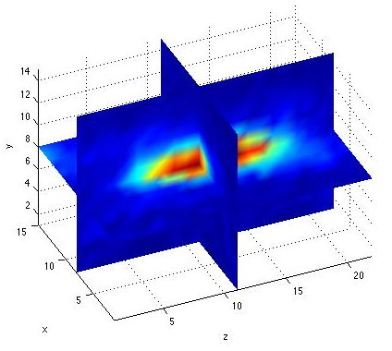
Determine window size for each bead
Window size for each bead was determined by:
finding maximum intensity of volume,
starting at the point of maximum intensity, scanning across x, y, and z lines until 10% of maximum intensity was found, and
determining volume from the scan and subsequently adding padding.
X-Y
Y-Z

Slide 8
Filtering “irregular” shaped bead volume
During search for the beads, two filters were passed
Filter 1: To filter out low intensity peaks:
Filter 2: To filter out lumped beads:
“Irregular shaped bead volume
Iso-surface of irregular shaped bead volume

Slide 9
Fitting each bead to 3D Gaussian Distribution
Each bead sub-volume was fitted to a 3D Gaussian distribution using a Lease-Squares fit:
The PSF’s theoretical solution for the confocal microscope is the Gaussian distribution [7].
Nine beads before fitting
Nine beads after fitting

Slide 10
Averaging the fitting parameters to determine the PSF.
The PSF was determined by imputing the average of each fitting parameter to a 3D Gaussian distribution:
X-Z
PSF for current configuration of microscope
X-Y
Y-Z

Slide 11
Lucy-Richardson deconvolution
PSF and volume will be fed into an iterative based deconvolution developed by Lucy-Richardson (LR) in 1972 [11]. The LR deconvolution is implemented in the “Deconvolution Lab” plugin within ImageJ [12].
The LR deconvolution maximizes the probability that the output image that is convolved with the PSF is an instance of the blurred image. When the best compromise between image detail enhancement and noise has been reached, the iterations are stopped.
This algorithm is good in mitigating background noise in the image because the model assumes a Poisson distributed of noise.
Computationally efficient compared to other methods.
Many other methods of deconvolution are available.

Slide 12
Validation of the LR dconvolution
To test the validity of the LR deconvolution, a ground truth image was convoluted with a known PSF.
A 100 iteration deconvolution was then preformed using LR deconvolution and consequently compared to the ground truth image.
*
=
PSF
Ground truth image
*⁻¹
Blurred image
=
PSF
Deblurred image

Slide 13
Deconvolution of volume with beads.
Blurred volume containing beads before deconvolution
Deblurred volume containing beads after deconvolution (10 iterations)

Slide 14
Blurred volume stack of neurons taken using LSCM
Blurred volume (512x512x66) of an aggregate of neurons seeded on a Polyacrylamide substrate.

Slide 15
Deconvoluted volume stack of neurons taken using LSCM (10 iterations)
10 iterations of the LR deconvolution on the previous volume stack of neurons (~1.5 minutes per channel).

Slide 16
Deconvoluted volume stack of neurons taken using LSCM (100 iterations)
100 iterations of the LR deconvolution on the previous volume stack of neurons (14 minutes per channel).

Slide 17
Sum of intensities projection.
Sum of intensity projection of volume stack of neurons (blurred)
Sum of intensity projection of volume stack of neurons (deblurred)

Slide 18
Conclusions
The PSF was determined using a statistical averaging of micro-fluorescent beads within a volume taken with LSCM.
The PSF and microscope image was deconvoluted using LR deconvolution in ImageJ.
A sharper image was produced with more iterations but loss of image color became increasingly worse.
Future work: Selfcontain the whole deconvolution procedure within MATLAB.
Thank you for your time.

Slide 19
References
[1] "Confocal Microscopy." The John Innes Centre. Web. 29 Apr. 2011. <http://www.jic.ac.uk/microscopy/more/T5_8.htm>..
[2] "Image of a double-labeled cell culture (right).."Microscopic and Microanalysis services. Web. 28 Apr 2011. <http://www.uku.fi/biomater/palvelut/mikroskopia_en.shtml>.
[3 Losavio, B. E., Y. Liang, A. Santamaria-Pang, I. A. Kakadiaris, C. M. Colbert, and P. Saggau. "Live Neuron Morphology Automatically Reconstructed From Multiphoton and Confocal Imaging Data." Journal of Neurophysiology 100.4 (2008): 2422-429. Web.
[4] "Point spread function." ImageSurfer. Web. 28 Apr 2011. <http://imagesurfer.cs.unc.edu/help/users-guide.html>.
[5] Pankajakshan, Praveen, Bo Zhang, Laure Blanc-Féraud, Zvi Kam, Jean-Christophe Olivo-Marin, and Josiane Zerubia. "Blind Deconvolution for Thin-layered Confocal Imaging."Applied Optics 48.22 (2009): 4437. Web.
[6] Pawley, James B. Handbook of Biological Confocal Microscopy. New York, NY: Springer, 2006. Web.
[7] Zhang, Bo, Josiane Zerubia, and Jean-Christophe Olivo-Marin. "Gaussian Approximations of Fluorescence Microscope Point-spread Function Models." Applied Optics 46.10 (2007): 1819. Web.
[8] Luisier, Florian, Cédric Vonesch, Thierry Blu, and Michael Unser. "Fast Interscale Wavelet Denoising of Poisson-corrupted Images." Signal Processing 90.2 (2010): 415-27. Web.
[9] Dupe, F.-X., J.M. Fadili, and J.-L. Starck. "A Proximal Iteration for Deconvolving Poisson Noisy Images Using Sparse Representations." IEEE Transactions on Image Processing18.2 (2009): 310-21. Web.
[10] Buades, A., B. Coll, and J. M. Morel. "A Review of Image Denoising Algorithms, with a New One." Multiscale Modeling & Simulation 4.2 (2005): 490. Web.
[11] Richardson, William Hadley. "Bayesian-Based Iterative Method of Image Restoration." Journal of the Optical Society of America 62.1 (1972): 55. Web.
[12] Vonesch, Cédric, Raquel T. Cristofani, and Guillaume Schmit. ImageJ: Deconvolution Lab. Computer software. 3D Deconvolution Package for Microscopic Images. Biomedical Image Group (BIG), ÉCOLE POLYTECHNIQUE FÉDÉRALE DE LAUSANNE. Web. <http://bigwww.epfl.ch/algorithms/deconvolutionlab/>.

