Slide 1
Quantifying knee osteoarthritis
Alice Chuang
April 28, 2011
En 250

Slide 2
Introduction
Osteoarthritis increasing in aging population
Imaging techniques:
Radiography (X-ray) – golden standard, qualitative
MRI - quantitative, gaining popularity
Spectroscopy
Ultrasound
Difficult to quantify progress
Joint space width – thickness of articular cartilage
Osteophyte formation – bony protrusion
Kellegren-Lawrence scale for severity of disease

Slide 3
Approach
Fully automatic quantification of knee osteoarthritis severity on plain radiographs. Oka H, Muraki S, et al. Osteoarthritis Cartilage. 2008 Nov;16(11):1300-6.
KOACAD – Knee osteoarthritis computer-aided diagnosis
Thresholds normalized to Kellegren-Lawrence scale based on cohort of 2975 Japanese adults

Slide 4
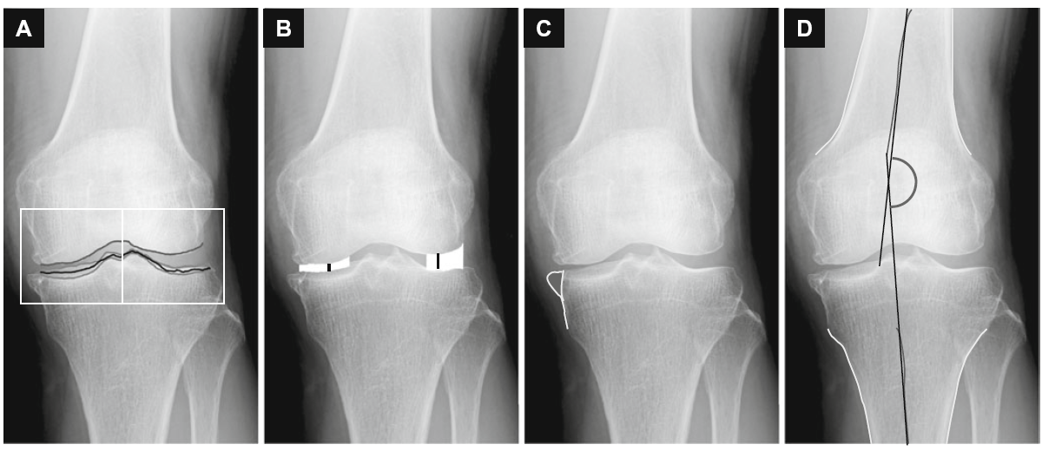
KOACAD
A) Boundaries C) Osteophyte area
B) Joint space width, area D) Femorotibial angle

Slide 5
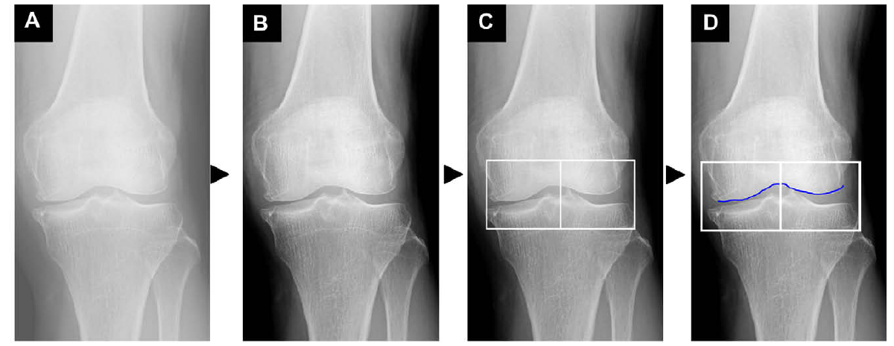
KOACAD
Part 1
A) Original image
B) Filtered image
C) Region of interest
Vertical neighborhood difference filter
D) Upper rim = femoral condyle
Vertical filtering with 3x3 square neighborhood difference filter

Slide 6
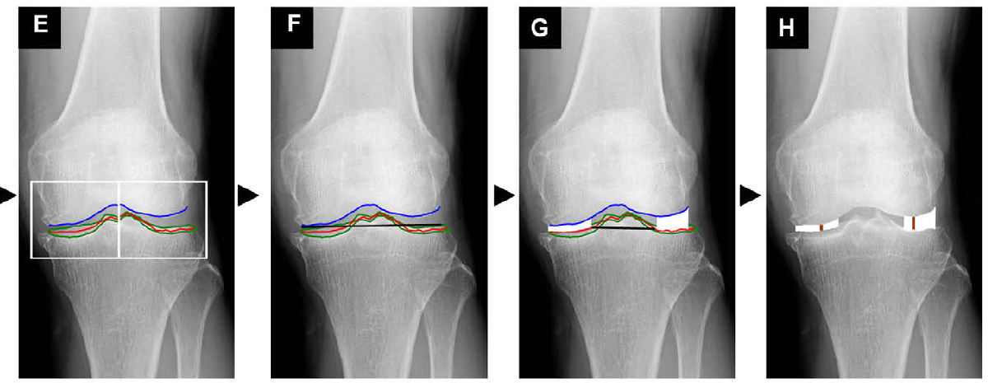
KOACAD
Part 2
E) Lower rim = Margins of tibial plateau
Anterior and posterior margins averaged
F) Straight regression line drawn of lower rim
G) Joint space area: inside rim, outside rim
Inner: Intersection of regression line, lower rim
H) Minimum joint space width
Minimum vertical space distance

Slide 7
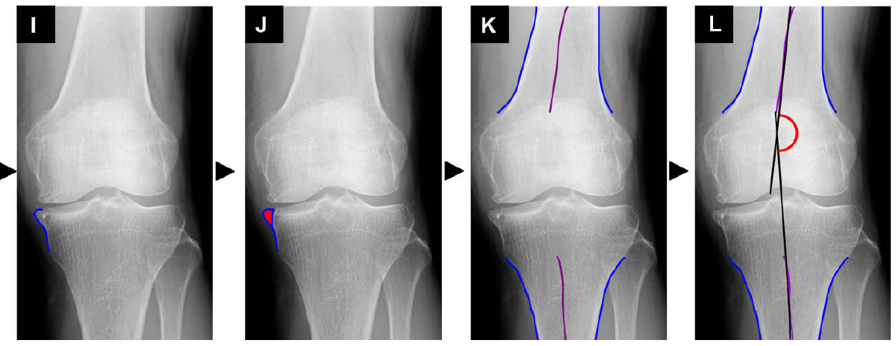
KOACAD
Part 3
I) Protrusion
Femur, tibia outlined by 3x3 square horizontal neighborhood difference filter
J) Osteophyte area = protrusion (inflection point)
K) Middle lines from outline of femur, tibia
L) Femorotibial angle: axes of femur, tibia
Straight-line regression of middle lines

Slide 8
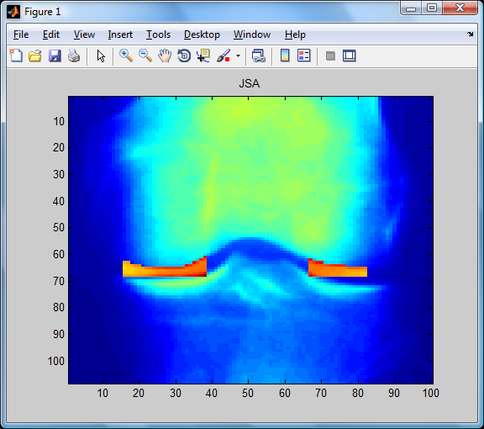
Preliminary Results
Normal knee, 2D x-ray
Values in pixels
Left:
Joint space area = 171
Min joint space width = 3
Right:
Joint space area = 149
Min joint space width = 3

Slide 9
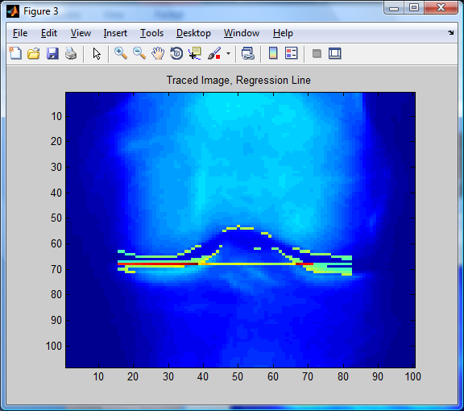
Process: Boundaries
Vertical difference filter
Upper: femoral condyle
Lower: tibial plateau
Linear regression
Inner: intersection of regression line and tibia
Outer: lateral joint border

Slide 10
Joint Space Characterization
Joint space width (JSW)
Vertical distance in pixels
Minimum JSW
Joint space area
Number of pixels
Sum of all JSW

Slide 11
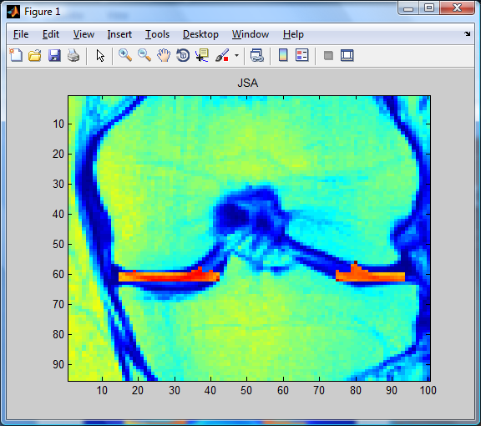
Slice of 3D image
Values in pixels
Left:
Joint space area = 151
Min joint space width = 2
Right:
Joint space area = 126
Min joint space width = 2

Slide 12
Weekly timeline
Accomplished
Week 1: Define boundaries of synovial capsule
Week 2: Quantify joint space width and area
Upcoming plan
Week 3: Define boundaries of osteophytes
Week 4: Quantify femorotibial angle

Slide 13
References
Oka H, Muraki S, Akune T, Nakamura K, Kawaguchi H, Yoshimura N. Normal and threshold values of radiographic parameters for knee osteoarthritis using a computer-assisted measuring system (KOACAD): the ROAD study. J Orthop Sci. 2010 Nov;15(6):781-9. Epub 2010 Nov 30.
Oka H, Muraki S, Akune T, Mabuchi A, Suzuki T, Yoshida H, Yamamoto S, Nakamura K, Yoshimura N, Kawaguchi H. Fully automatic quantification of knee osteoarthritis severity on plain radiographs. Osteoarthritis Cartilage. 2008 Nov;16(11):1300-6. Epub 2008 Apr 18.
Cooke TD. Re: "Fully automatic quantification of knee osteoarthritis severity on plain radiographs". Authors: H. OKA et al. Osteoarthritis and Cartilage (2008) 16, 1300-1306. Osteoarthritis Cartilage. 2009 Sep;17(9):1252-3; author reply 1254. Epub 2009 Mar 28.
Johansson A, Sundqvist T, Kuiper JH, Öberg PÅ. A spectroscopic approach to imaging and quantification of cartilage lesions in human knee joints. Phys Med Biol. 2011 Mar 21;56(6):1865-78. Epub 2011 Mar 1.
Dodin P, Pelletier JP, Martel-Pelletier J, Abram F. Automatic Human Knee Cartilage Segmentation from 3D Magnetic Resonance Images. IEEE Trans Biomed Eng. 2010 Jul 15. [Epub ahead of print]
Bowers ME, Trinh N, Tung GA, Crisco JJ, Kimia BB, Fleming BC. Quantitative MR imaging using "LiveWire" to measure tibiofemoral articular cartilage thickness. Osteoarthritis Cartilage. 2008 Oct;16(10):1167-73. Epub 2008 Apr 14.

Slide 14
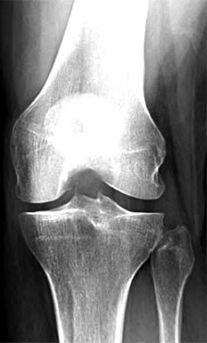
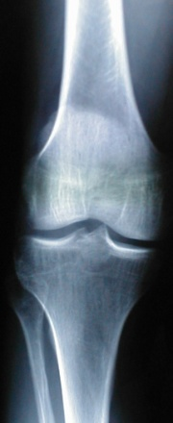
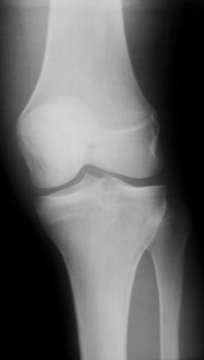
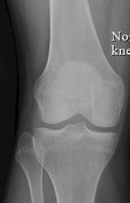
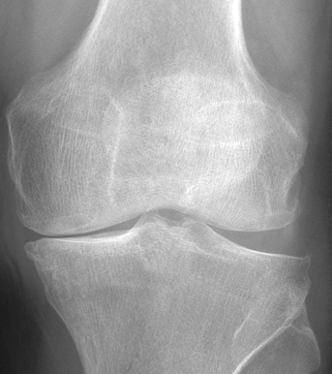
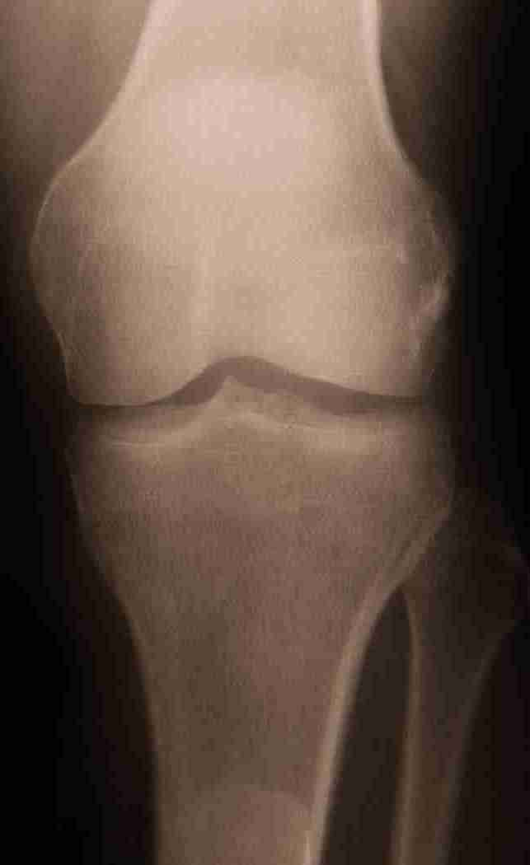
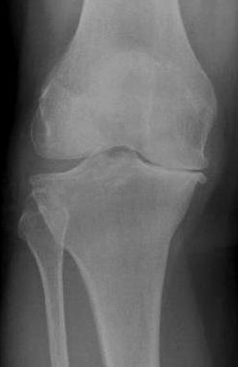
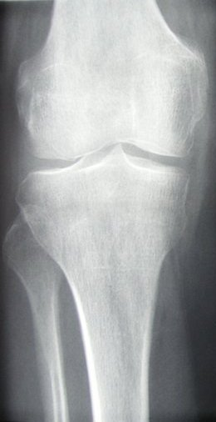
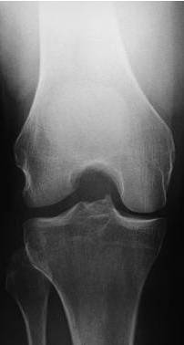
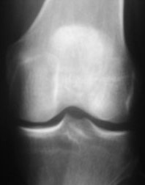
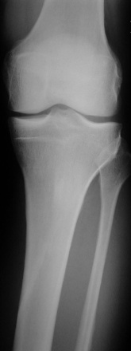
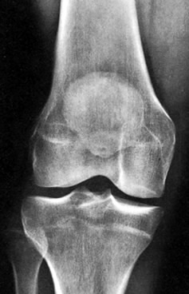
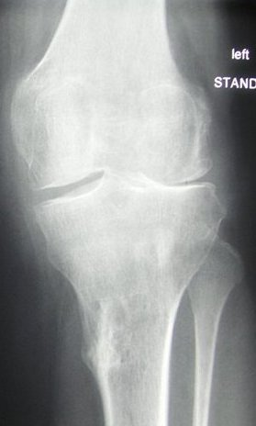
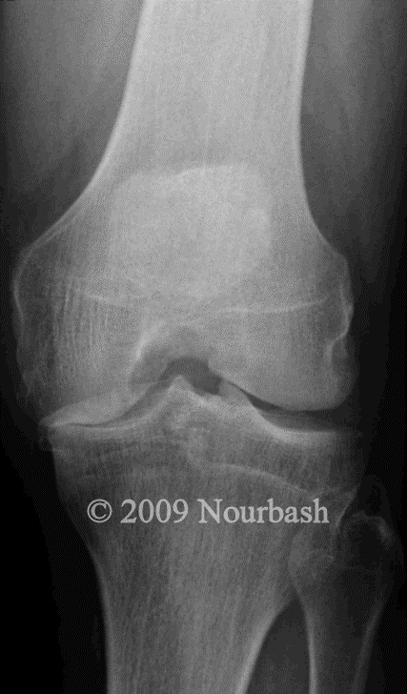
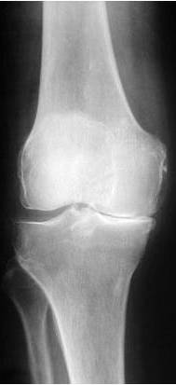
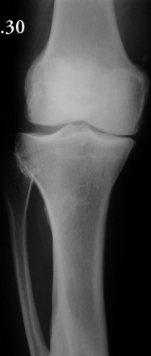
Sample knee x-rays
Normal
osteoarthritic

Slide 15
Knee X-ray Sources
Osteoarthritic:
http://www.mayoclinic.com/images/image_popup/mcdc7_kneearthritis.jpg
http://4.bp.blogspot.com/_uC-1Is5ZK44/S-wAlZJ0X9I/AAAAAAAAAQY/w7KHexuDZqA/s1600/Knee%2520X-Ray.jpg
http://3.bp.blogspot.com/_vT13IccOEqM/TL87gkX7JGI/AAAAAAAAASo/8HLvpat1nvo/s1600/89.jpg
http://www.ispub.com/ispub/ijos/volume_5_number_1_27/patella_refashioning_during_tkr_in_patient_with_previous_bilateral_patellectomy_using_bone_cuts/tkr-fig1.jpg
http://www.ispub.com/ispub/ijos/volume_5_number_1_27/patella_refashioning_during_tkr_in_patient_with_previous_bilateral_patellectomy_using_bone_cuts/tkr-fig1.jpg
http://www.hipandkneespecialist.com/knee_arth1B%20Nourbash.gif
http://www.sciencephoto.com/images/showFullWatermarked.html/C0075866-X-Rays_of_Normal_and_Degenerative_Knees-SPL.jpg?id=670075866
http://www.hwbf.org/hwb/conf/mill1/981030.jpg
Normal:
http://img.photobucket.com/albums/v110/shanbhag/AchesandJoints/ANJ3-KneeXray-s.jpg
http://fiftyone43four.files.wordpress.com/2010/06/knee_xray_normal.jpg
http://imagecache6.allposters.com/LRG/30/3041/GZPBF00Z.jpg
http://www.sciencephoto.com/images/showFullWatermarked.html/C0075866-X-Rays_of_Normal_and_Degenerative_Knees-SPL.jpg?id=670075866
http://www.health.com/health/static/hw/media/medical/hw/h9991217.jpg
http://4.bp.blogspot.com/_aG90Nx5mMjw/TSI5OmNwlVI/AAAAAAAAB6s/ZHfANxI-m9A/s640/normal-knee-xray.jpg
http://www.hwbf.org/hwb/conf/mill1/981030.jpg
http://www.stryker.mudbugmedia.com/images/library/stryker_xrays/normal_knee_xray.jpg

