Slide 1
Quantifying knee osteoarthritis
Alice Chuang
April 28, 2011
En 250

Slide 2
Introduction
Osteoarthritis increasing in aging population
Imaging techniques:
Radiography (X-ray) – golden standard, qualitative
MRI - quantitative, gaining popularity
Spectroscopy
Ultrasound
Difficult to quantify progress
Joint space width – thickness of articular cartilage
Osteophyte formation – bony protrusion
Kellegren-Lawrence scale for severity of disease

Slide 3
Approach
Fully automatic quantification of knee osteoarthritis severity on plain radiographs. Oka H, Muraki S, et al. Osteoarthritis Cartilage. 2008 Nov;16(11):1300-6.
KOACAD – Knee osteoarthritis computer-aided diagnosis
Thresholds normalized to Kellegren-Lawrence scale based on cohort of 2975 Japanese adults

Slide 4
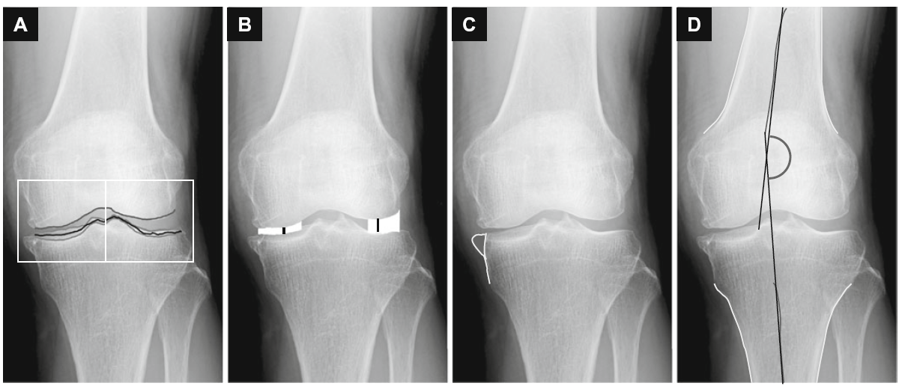
KOACAD
A) Boundaries C) Osteophyte area
B) Joint space width, area D) Femorotibial angle

Slide 5
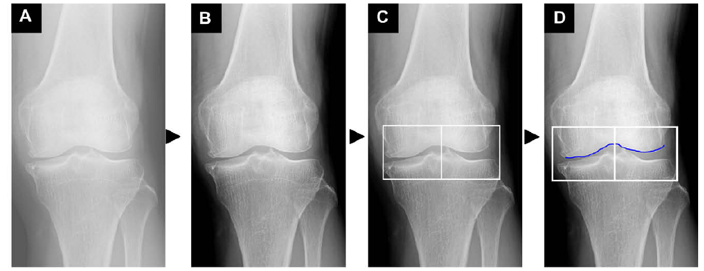
KOACAD
Part 1
A) Original image
B) Filtered image
C) Region of interest
Vertical neighborhood difference filter
D) Upper rim = femoral condyle
Vertical filtering with 3x3 square neighborhood difference filter

Slide 6
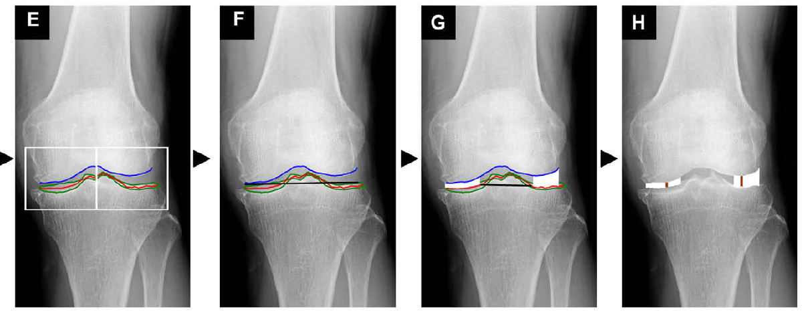
KOACAD
Part 2
E) Lower rim = Margins of tibial plateau
Anterior and posterior margins averaged
F) Straight regression line drawn of lower rim
G) Joint space area: inside rim, outside rim
Inner: Intersection of regression line, lower rim
H) Minimum joint space width
Minimum vertical space distance

Slide 7
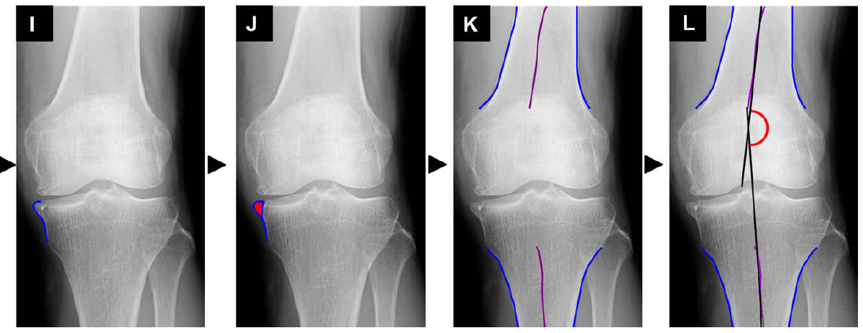
KOACAD
Part 3
I) Protrusion
Femur, tibia outlined by 3x3 square horizontal neighborhood difference filter
J) Osteophyte area = protrusion (inflection point)
K) Middle lines from outline of femur, tibia
L) Femorotibial angle: axes of femur, tibia
Straight-line regression of middle lines

Slide 8
Goal of Project
Create a Matlab program mimicking KOACAD
Quantify disease state of osteoarthritis
Use 2D radiographs
Successes
mJSW – minimum joint space width
JSA – joint space area
FTA – femorotibial angle
Future
Osteophyte area – protrusions near joint
Automation
Filter images

Slide 9
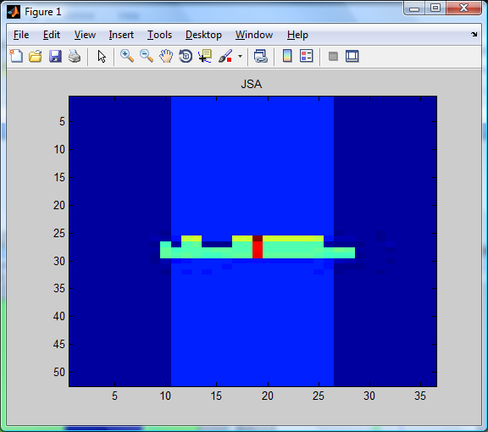
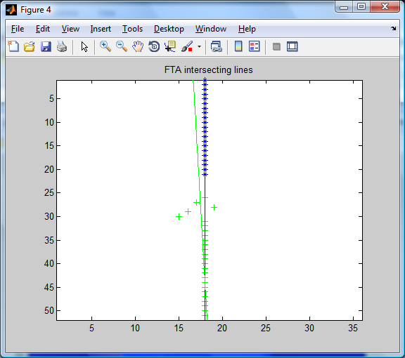
First results: Test images
Simple cartoon images to test Matlab program
Top image, results in pixels
Left
JSA (joint space area) = 24
min JSW (joint space width) = 1
Right
JSA = 27
min JSW = 1
Bottom, result in degrees
FTA (femorotibial angle)
= 178.2
Notes:
koacad(test,5,1,1,800,5)

Slide 10
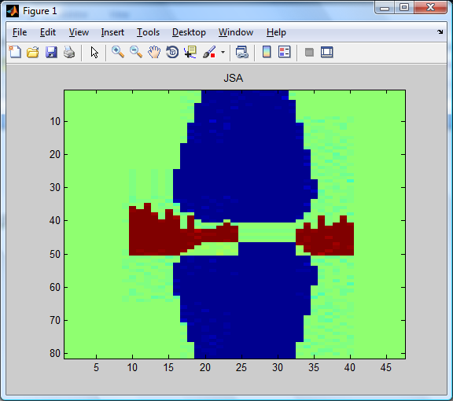
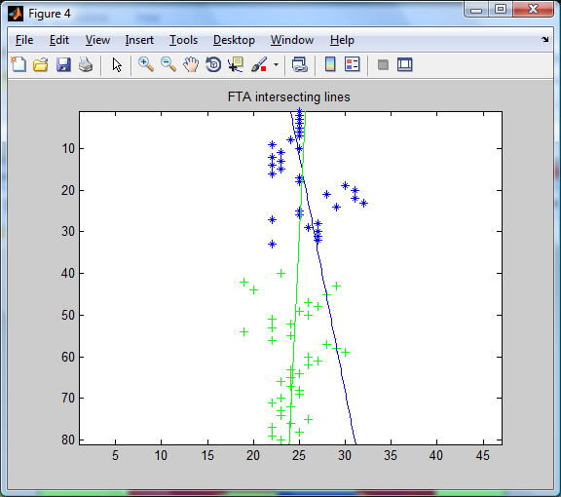
Test images
Top, joint space in pixels
Left
JSA = 462
min JSW = 6
Right
JSA = 154
min JSW = 7
Bottom, angle in degrees
FTA = 173.7
Test images show that Matlab program works on idealized images
Notes:
koacad(FTA_test,5,1,1,800,5)

Slide 11
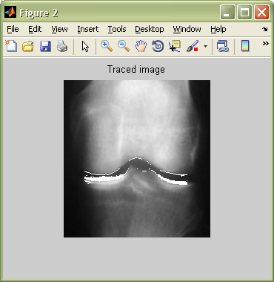
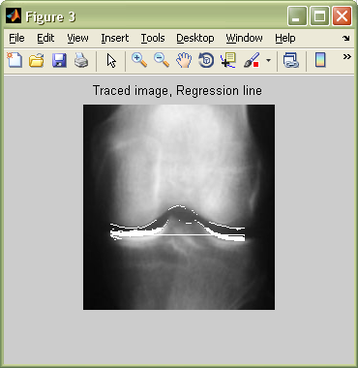
Process: Boundaries
Vertical difference filter
User control
Threshold as percent of intensity
Upper: femoral condyle
Lower: tibial plateau
Linear regression
Inner: intersection of regression line and tibia
Outer: lateral joint border
Notes:
koacad(p_n6,12,1,1.05,800,3)

Slide 12
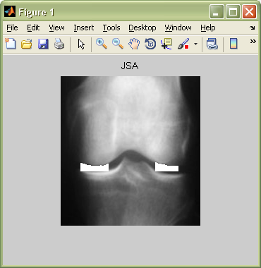
Joint Space Characterization
Joint space width (JSW)
Vertical distance in pixels
Minimum JSW
Left: mJSW = 7
Right: mJSW = 7
Joint space area (JSA)
Number of pixels
Sum of all JSW
Left: JSA = 682
Right: JSA = 1076
Can normalize pixel values
Notes:
koacad(p_n6,12,1,1.05,800,3)

Slide 13
Joint Space Results
Successes
Upper, lower, inner, and outer bounds identified
More shading on lateral sides of joint
Adjusting threshold for vertical neighbor difference
Summing algorithm for Joint Space characterization
Difficulties
Slanted alignment of images
Background noise unfiltered
Dimensions vary
Manual zooming-in is labor intensive

Slide 14
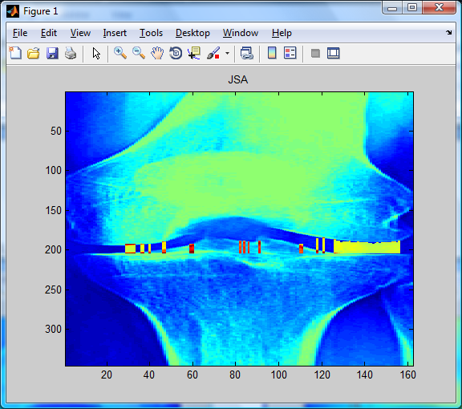
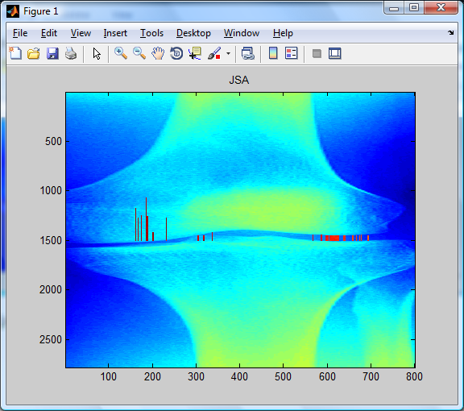
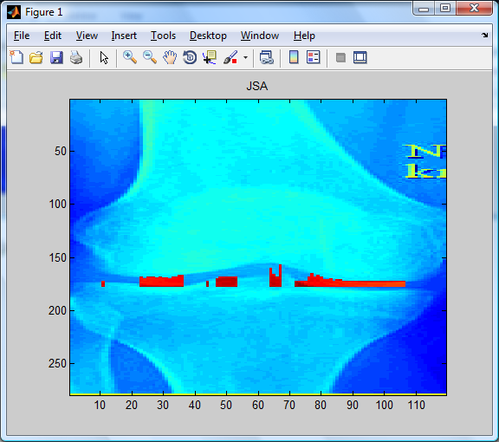
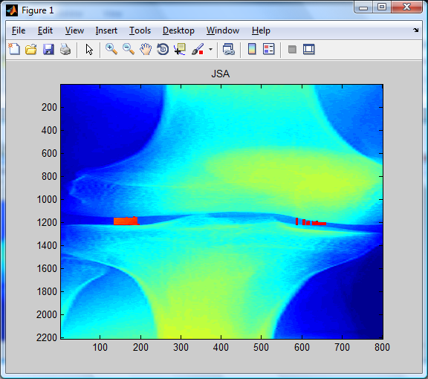
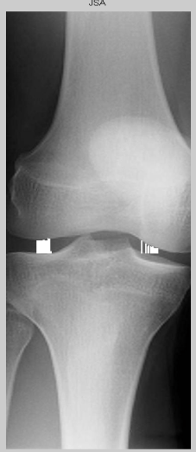
Joint Space Results
Left
JSA = 240
mJSW = 11
Right
JSA = 1377
mJSW = 11
Left
JSA = 371
mJSW = 5
Right
JSA = 808
mJSW = 5
Left
JSA = 23041
mJSW = 62
Right
JSA = 4869
mJSW = 60
Left
JSA = 10749
mJSW = 13
Right
JSA = 6746
mJSW = 26
Notes:
koacad(n1,24,1,1.22,800,20)
koacad(n5,5,1.07,1.2,800,8)
koacad(ser5,5,1.02,1,800,5)
koacad(ser8,5,1,1,800,3) (takes a while)

Slide 15
Test image: FTA
Top, results in pixels
Left
JSA = 462
min JSW = 6
Right
JSA = 154
min JSW = 7
Bottom, result in degrees
FTA (femorotibial angle)
= 173.7
Notes:
koacad(FTA_test,5,1,1,800,5)

Slide 16
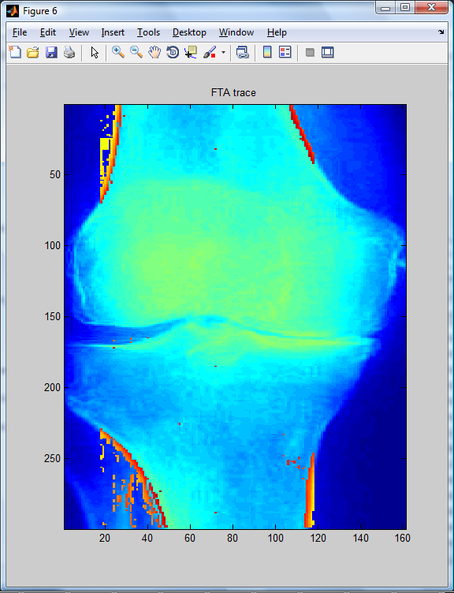
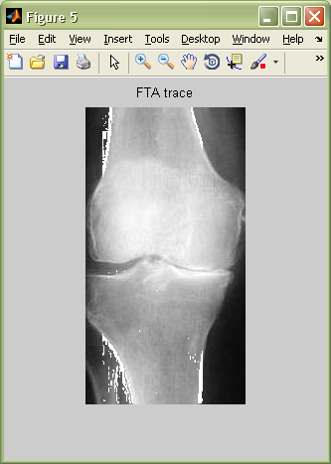
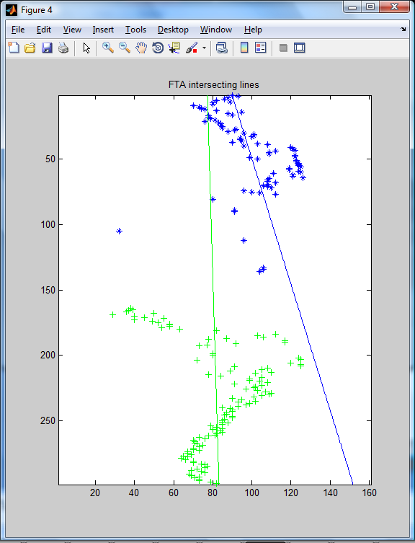
Process: Midline Regression
Horizontal difference filter
User control
Intensity threshold
Medial regression lines
Femur – blue
Tibia – green
Notes:
koacad(oa7,8,0.975,1,800,10)
koacad(oa7,8,0.975,1,800,5)

Slide 17
Femorotibial Angle
Regression lines
Slope m
m1 – Femur , blue
m2 – Tibia, green
tan(FTA) = (m1 – m2)
(1 + m1*m2)
FTA = 169.4 degrees
Same limitations as JSA
Intensity distribution
Highly variable
Notes:
koacad(oa7,8,0.975,1,800,5)

Slide 18
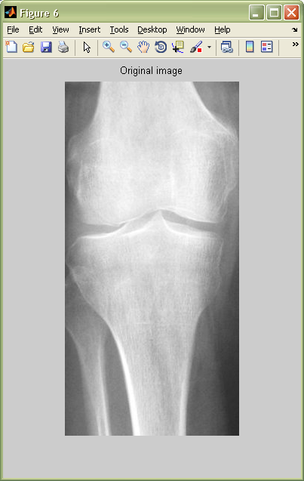
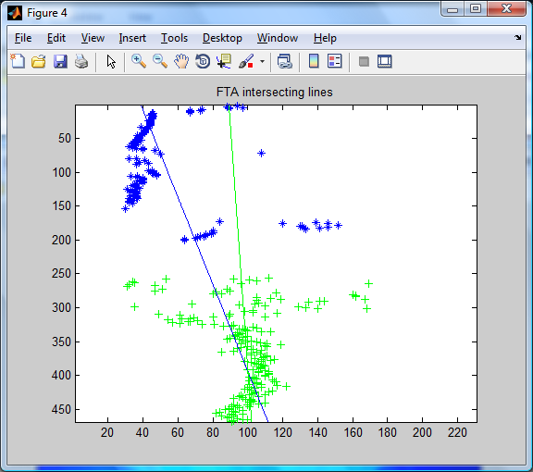
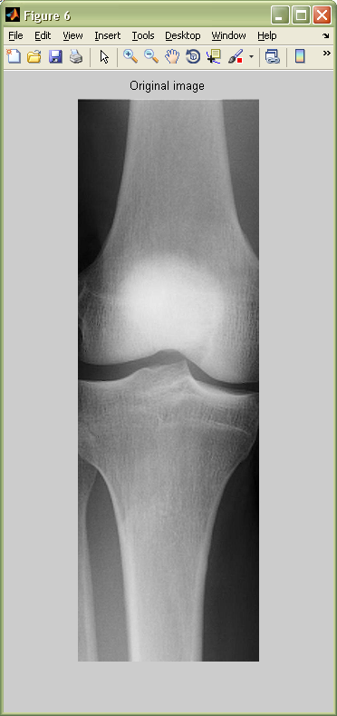
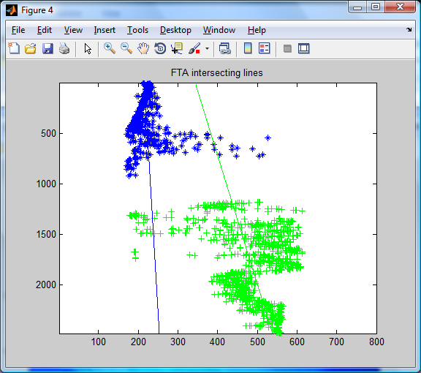
Femorotibial Angle Results
FTA
= 172.8
FTA
= 176.4
Notes:
koacad(oa5,6,0.88,1,800,5)
koacad(ser2,3,0.94,0.9,800,3) (takes a long time)

Slide 19
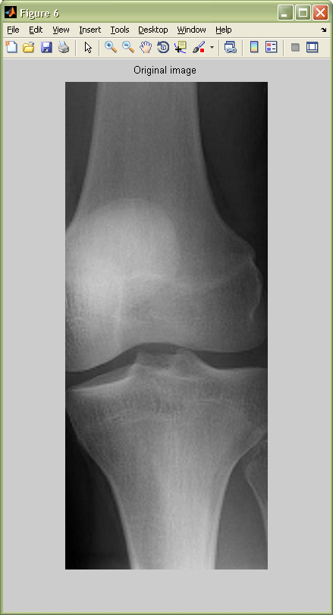
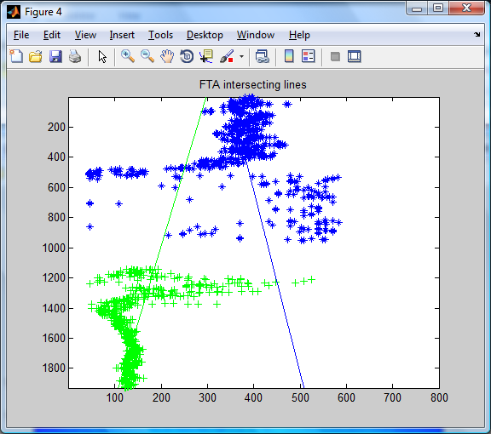
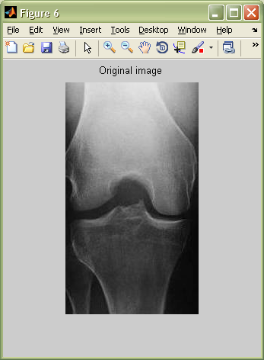
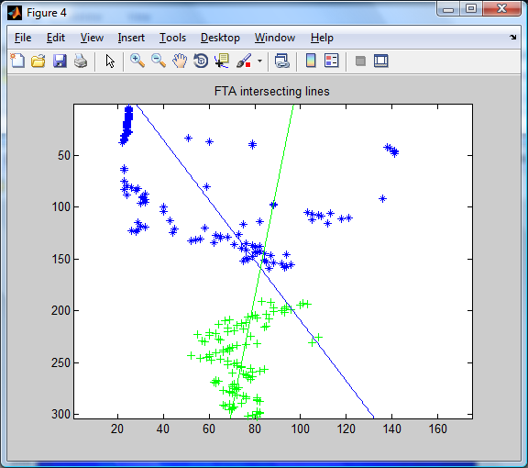
Femorotibial Angle Results
FTA
= 169.6
FTA
= 155.8
Notes:
koacad(ser7,5,1,1.1,800,3) (takes a long time)
koacad(n4,20,1,1.1,800,8)

Slide 20
Combining analyses
Example of normal knee
Joint space evaluation
Left
JSA (joint space area) = 371
min JSW (joint space width) = 5
Right
JSA = 808
min JSW = 5
Femorotibial angle
FTA = 171.2 degrees
Notes:
koacad(n5,5,1.07,1.2,800,8)

Slide 21
Combining analyses
Osteoarthritic knee
Right joint space undetectable
Joint space evaluation
Left
JSA (joint space area) = 884
min JSW (joint space width) = 7
Right
JSA = 19
min JSW = 7
Femorotibial angle
FTA = 169.4 degrees
Notes:
koacad(oa7,8,0.975,1,800,10)
koacad(oa7,8,0.975,1,800,5)

Slide 22
Conclusion
Numerical comparison of 2D x-rays
Osteoarthritic mJSW and JSA pixel values
FTA – angle of joint bones possible sign of osteoarthritis
Future improvements
Osteophyte area, as done in KOACAD
Image quality
Intensity distribution
Background signals
Automation
Filtering
Threshold detection
Atlas mapping
Compare with 3D imaging

Slide 23
References
Primary source:
Oka H, Muraki S, Akune T, Mabuchi A, Suzuki T, Yoshida H, Yamamoto S, Nakamura K, Yoshimura N, Kawaguchi H. Fully automatic quantification of knee osteoarthritis severity on plain radiographs. Osteoarthritis Cartilage. 2008 Nov;16(11):1300-6. Epub 2008 Apr 18.
Additional sources:
Oka H, Muraki S, Akune T, Nakamura K, Kawaguchi H, Yoshimura N. Normal and threshold values of radiographic parameters for knee osteoarthritis using a computer-assisted measuring system (KOACAD): the ROAD study. J Orthop Sci. 2010 Nov;15(6):781-9. Epub 2010 Nov 30.
Cooke TD. Re: "Fully automatic quantification of knee osteoarthritis severity on plain radiographs". Authors: H. OKA et al. Osteoarthritis and Cartilage (2008) 16, 1300-1306. Osteoarthritis Cartilage. 2009 Sep;17(9):1252-3; author reply 1254. Epub 2009 Mar 28.
Johansson A, Sundqvist T, Kuiper JH, Öberg PÅ. A spectroscopic approach to imaging and quantification of cartilage lesions in human knee joints. Phys Med Biol. 2011 Mar 21;56(6):1865-78. Epub 2011 Mar 1.
Dodin P, Pelletier JP, Martel-Pelletier J, Abram F. Automatic Human Knee Cartilage Segmentation from 3D Magnetic Resonance Images. IEEE Trans Biomed Eng. 2010 Jul 15. [Epub ahead of print]
Bowers ME, Trinh N, Tung GA, Crisco JJ, Kimia BB, Fleming BC. Quantitative MR imaging using "LiveWire" to measure tibiofemoral articular cartilage thickness. Osteoarthritis Cartilage. 2008 Oct;16(10):1167-73. Epub 2008 Apr 14.

Slide 24
Knee X-ray Sources
Primary image source:
Dr. Braden Fleming, Coro Research Center
Additional osteoarthritic knee x-rays:
http://www.mayoclinic.com/images/image_popup/mcdc7_kneearthritis.jpg
http://4.bp.blogspot.com/_uC-1Is5ZK44/S-wAlZJ0X9I/AAAAAAAAAQY/w7KHexuDZqA/s1600/Knee%2520X-Ray.jpg
http://3.bp.blogspot.com/_vT13IccOEqM/TL87gkX7JGI/AAAAAAAAASo/8HLvpat1nvo/s1600/89.jpg
http://www.ispub.com/ispub/ijos/volume_5_number_1_27/patella_refashioning_during_tkr_in_patient_with_previous_bilateral_patellectomy_using_bone_cuts/tkr-fig1.jpg
http://www.ispub.com/ispub/ijos/volume_5_number_1_27/patella_refashioning_during_tkr_in_patient_with_previous_bilateral_patellectomy_using_bone_cuts/tkr-fig1.jpg
http://www.hipandkneespecialist.com/knee_arth1B%20Nourbash.gif
http://www.sciencephoto.com/images/showFullWatermarked.html/C0075866-X-Rays_of_Normal_and_Degenerative_Knees-SPL.jpg?id=670075866
http://www.hwbf.org/hwb/conf/mill1/981030.jpg
Additional normal knee x-rays:
http://img.photobucket.com/albums/v110/shanbhag/AchesandJoints/ANJ3-KneeXray-s.jpg
http://fiftyone43four.files.wordpress.com/2010/06/knee_xray_normal.jpg
http://imagecache6.allposters.com/LRG/30/3041/GZPBF00Z.jpg
http://www.sciencephoto.com/images/showFullWatermarked.html/C0075866-X-Rays_of_Normal_and_Degenerative_Knees-SPL.jpg?id=670075866
http://www.health.com/health/static/hw/media/medical/hw/h9991217.jpg
http://4.bp.blogspot.com/_aG90Nx5mMjw/TSI5OmNwlVI/AAAAAAAAB6s/ZHfANxI-m9A/s640/normal-knee-xray.jpg
http://www.hwbf.org/hwb/conf/mill1/981030.jpg
http://www.stryker.mudbugmedia.com/images/library/stryker_xrays/normal_knee_xray.jpg

