Slide 1
Segmentation of Dog Elbow Bones Using Max Flow/Min Cut Graph Cuts
Based on "An Experimental Comparison of Min-Cut/Max-Flow Algorithms for Energy Minimization in Vision.“ by Yuri Boykov and Vladimir Kolmogorov.

Slide 2
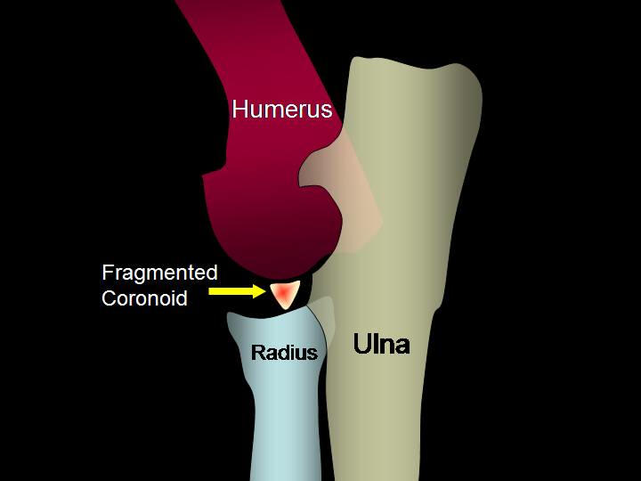
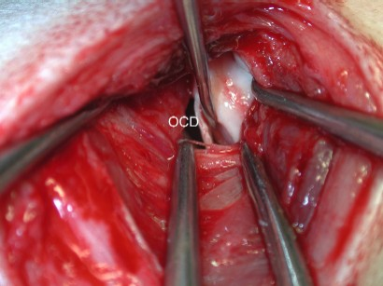
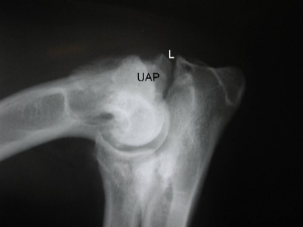
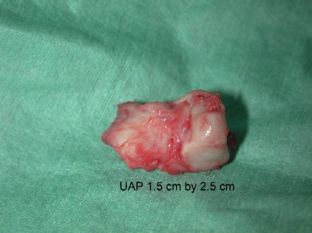
The Problem: Dog Elbow Dysplasia
Fragmented coronoid process (FCP)
Osteochondritis of the medial humeral condyle in the elbow joint (OCD)
Ununited anconeal process (UAP)
http://www.michvet.com/library/surgery_elbow_fcp.asp
http://www.vetsurgerycentral.com/elbow_dysplasia.htm
http://www.vetsurgerycentral.com/elbow_dysplasia.htm
Notes:
FCP: small piece of bone breaks off ulna
OCD: small piece of cartilage partially or totally breaks off
UAP: bones fail to fuse in youth

Slide 3
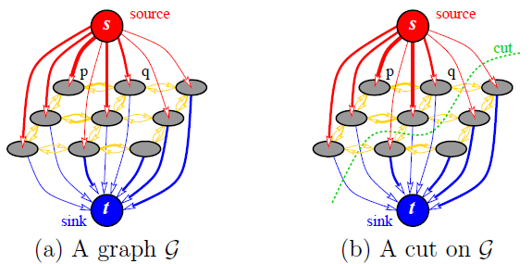
Graph Cuts in Theory
Treat pixels as set of nodes
Treat labels (bone/not bone) as source/sink
Assign costs for cuts
Find most efficient cut
Boykov and Kolmogorov

Slide 4
Preliminary Results
Import images using Corona imaging package
Assign weights to edges based on pixel intensity differences
Assign weights to edges based on intensity

Slide 5
Refined Cost Functions
Parameter ρ between 0 and 1⇒ ρ=0.9
ρ*[label cost]
(1- ρ)*[neighbor cost]
Parameter α between 1 and 10 ⇒ α=4
α*[relative brightness]=cost of not being bone
[relative darkness]=cost of being bone

Slide 6
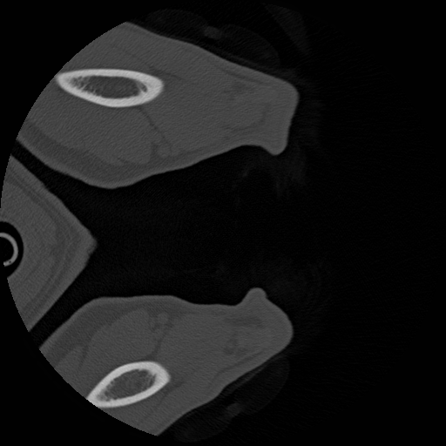
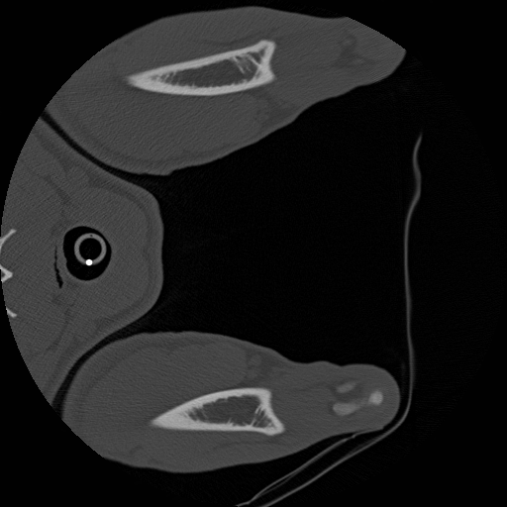
Final Results
Notes:
Top: BDH slice 31
Botom: Sporer slice 31

Slide 7
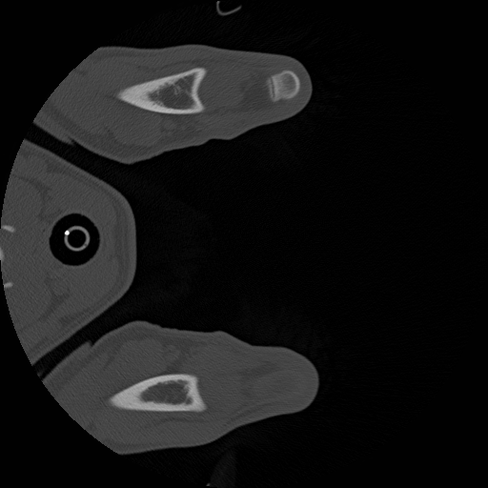
Final Results
Notes:
slice 106 Neef_77933_PraeOP.vtk

Slide 8
Final Results
Notes:
slice 105 Neef_77933_PraeOP.vtk

Slide 9
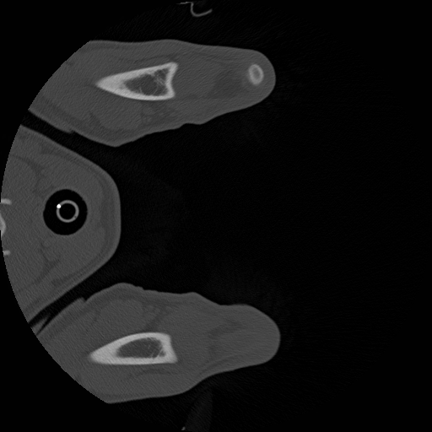
Final Results
Notes:
slice 103 Neef_77933_PraeOP.vtk

Slide 10
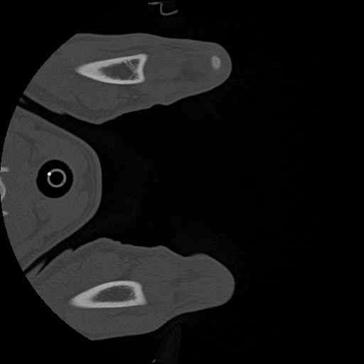
Final Results
Notes:
slice 101 Neef_77933_PraeOP.vtk

Slide 11
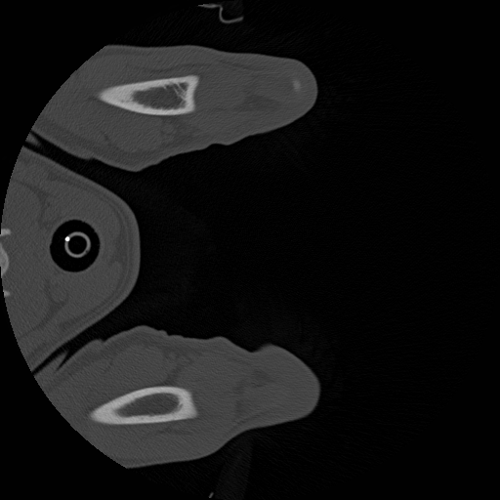
Final Results
Notes:
slice 99 Neef_77933_PraeOP.vtk

Slide 12
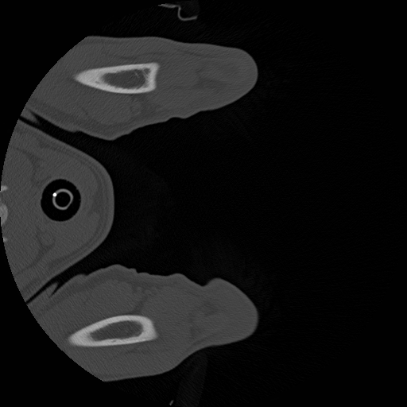
Final Results
Notes:
slice 97 Neef_77933_PraeOP.vtk

Slide 13
Final Results
Notes:
slice 95 Neef_77933_PraeOP.vtk

Slide 14
Future Directions
Minimum cluster size to eliminate noise
Eliminate encapsulated dark spots to eliminate marrow areas
3D Visualization tools
Cost function refinement

Slide 15
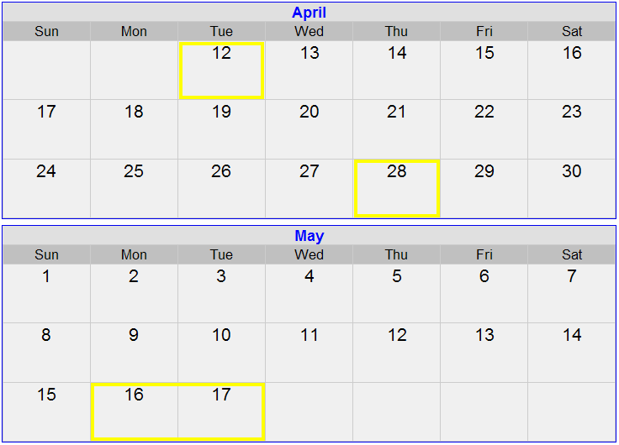
Project Timeline
Weeks 1-2
Revive/write code
Test with phantom images
Mid-Project Presentation
Preliminary Results
Weeks 3-4
Write display code
Run algorithm on real data
Write report/presentation

Slide 16
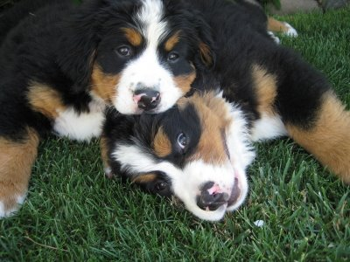
Questions?
Thank you.
http://www.istockphoto.com/stock-photo-5095712-two-bernese-mountain-dog-puppies-in-grass.php

